Slide 1
For weedmodels paper
Figures etc

Slide 2
a
b
c
d
Figure 1. a)wplot_basic showing archaeobotanical samples against model 1. b) wplot_geog showing archaeobotanical samples against model 2. c) wplot_arch showing archaeobotanical sample against the centroids of model 1. d) wplot_phase showing archaeobotanical samples plotted by phase against model 1 centroids.

Slide 3
Table 2 The format of the raw dataset from Stafford showing the first 8 samples and first 12 taxa. Full dataset in supplementary data. The rows in bold are composite species and the first column shows the species codes for each taxa obtained from X.
Notes:
Table 2 The format of the raw dataset from Stafford showing the first 8 samples and first 12 taxa. Full dataset in supplementary data. The rows in bold are composite species and the first column shows the species codes for each taxa obtained from X.

Slide 4
Table 3. The format of the second spreadsheet required: flowering periods. The first 12 species from Stafford are shown with composite species in bold.
Notes:
Table 3. The format of the second spreadsheet required: flowering periods. The first 12 species from Stafford are shown with composite species in bold.

Slide 5
Table 4 The new species codes for the composite taxa from Stafford and their included species
Notes:
Table 4 The new species codes for the composite taxa from Stafford and their included species

Slide 6
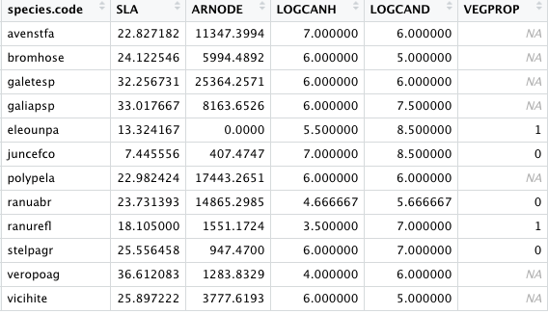
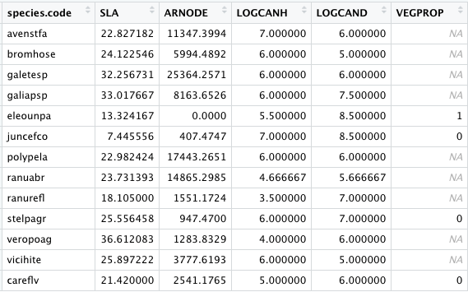
a
b
Figure 2 ( or table?)
Notes:
Figure 2 (or table?

Slide 7
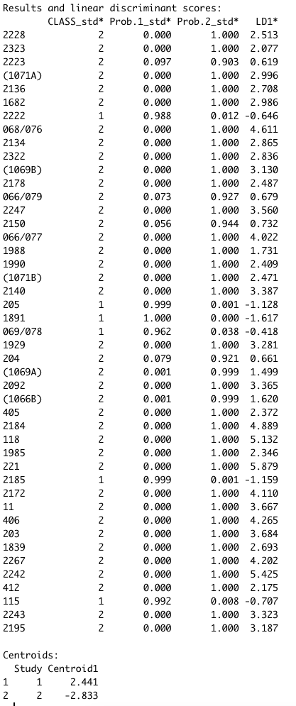
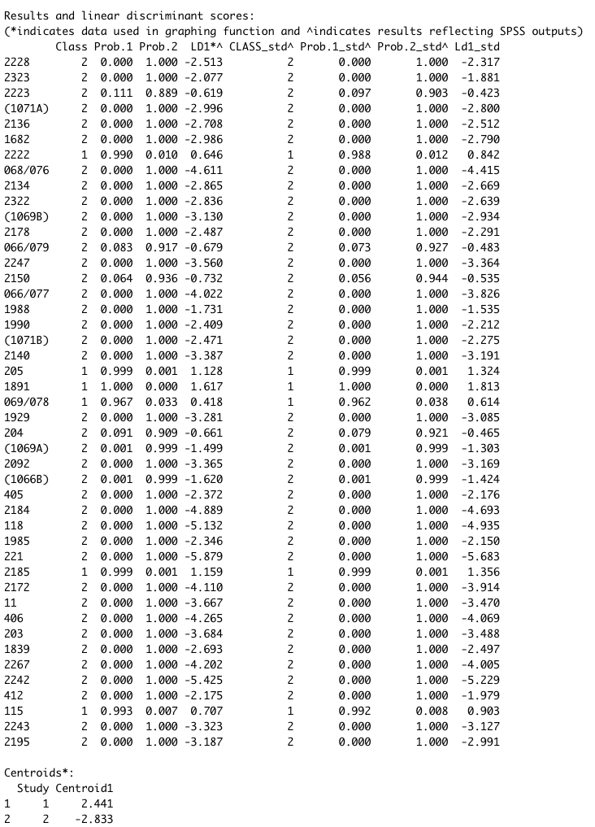
old
Table 6 - NEW
Notes:
Figure 3

Slide 8
A
B
Figure 3. A) the output of wplot_phase using the Stafford data and model 1. B) figure 7 from Hamerow et al (2020) showing the same data.
Notes:
Figure X

Slide 9
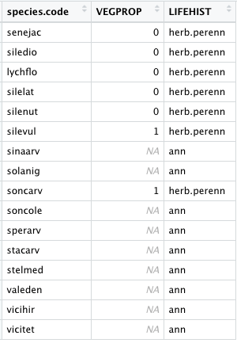
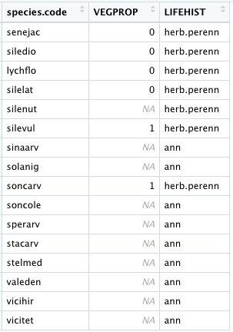
Table 7. A subset of the results of the function weed_data (a) and then the changed entre for silenut in (b)
a
b
Or table?
Notes:
Table 7

Slide 10
a
b
c
d
Figure 4
Notes:
Figure 5

Slide 11
Supplementary data
File 1 - model data
File 2 - species trait database
File 3 - four three codes <- excel file speciescodes
File 4 – flow chart of usage
File 5- cleaned Stafford data
File 6- flowering period
File 7- output of wdata_org
Supplementary code – Stafford script

Slide 13
ranuacr
SLA: 24.029
ranubul
SLA: 19.252
ranurep
SLA: 27.914
ranuacr
ARNODE:
18885.11
ranubul
ARNODE:
5524.933
ranurep
ARNODE:
20185.852
ranuacr
LOGCANH:
5
ranubul
LOGCANH:
4
ranurep
LOGCANH:
5
ranuacr
LOGCAND:
4
ranubul
LOGCAND:4
ranurep
LOGCAND:
9
ranuacr
VEGPROP:
0
ranubul
VEGPROP:
0
ranurep
VEGPROP:
1
ranuabr
SLA: 23.731
ranuabr
ARNODE:
14865.3
ranuabr
LOGCANH:
4.667
ranuabr
LOGCAND:
5.667
ranuabr
VEGPROP:
0
ranuabr
Repeat for all composite species
Modify VEGPROP
Add missing species
Notes:
Figure 2 ? Is this needed?

